Slide 1

Washing Machine Digital design assignment submitted to Mixel company
Prepared by: Mohamed Eslam Mohamed Mosa
Email:mohamedeslam22.me@gmail.com

Slide 2
Files attached
THIS PRESENTATON CONTAINS VOICE EXPLANATION OF SOME SLIDE
THE SUBMITTED FILE HAS THIS PRESENTATION AND FOLLOWING FILES
1) washing machine real design and its test bench under names:
Washing_Machine_real and Washing_Machine_real_TB
2) washing machine simpler design and its test bench under names:
Washing_Machine_simple and Washing_Machine_simple_TB
which differ from the real case only in 1-time of operation of each function (smaller)
2-clock frequency (smaller)
I added the simpler one as time for simulation of real case is very long

Slide 3
Presentation Outlines
1) explanation of the problem/requirements
2) design code explanation
3) testbench explanation
4) test cases for 1MHz clock frequency
5) test cases for smaller numbers(a smaller number of cycles)

Slide 4
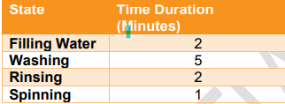
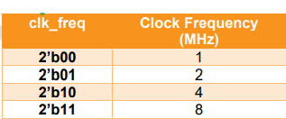
Problem and Requirements
We wish to design a washing machine that has following states
Where each of them take duration to be completed.
We also need this machine to work on several frequencies

Slide 5
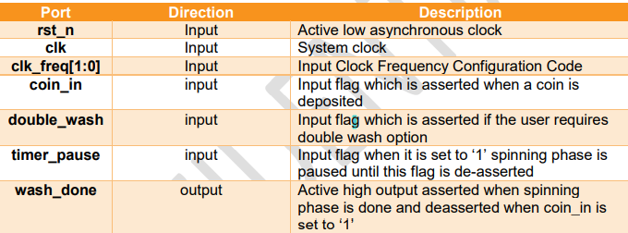
Problem and Requirements
The inputs and output of this machine are shown in the figure
There are inputs which act like flags that change the normal flow of the process like “timer pause” and “double wash” ,which explained in FSM diagram.

Slide 6
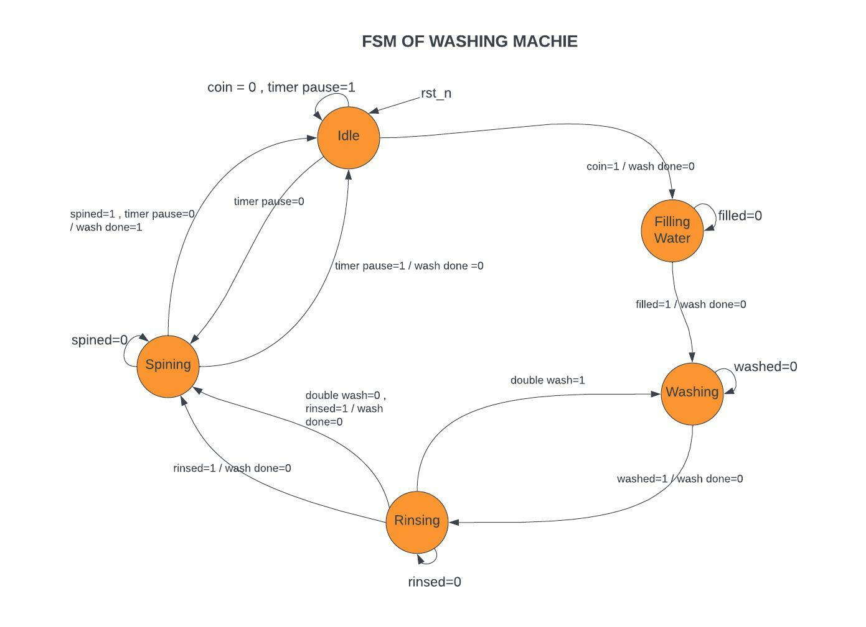
Problem and Requirements
Here we start at idle case where it wait for the user to input a coin to start the operation.
After that it goes to “fill water” state and stay there until it’s flag “filled” is 1.
Then into “washing” state and stay there until it’s flag “washed” is 1.
Then into “rinsing” state and stay there until it’s flag “rinsed” is 1.

Slide 7
Problem and Requirements
After finish the “rinsing” state it check “double wash” input which simply allow user to wash and rinse cloth for one more time.
Then it enter “spinning” state and stay there until it’s flag “spined” is 1.
When it enters “spinning” state it check “timer pause” flag which when asserted only in “spinning” ; machine does nothing and go to “idle” until it deasserted,it return to “spinning” and wait to complete its operation time if its not done yet
After all of this the “wash done” is equal 1

Slide 8
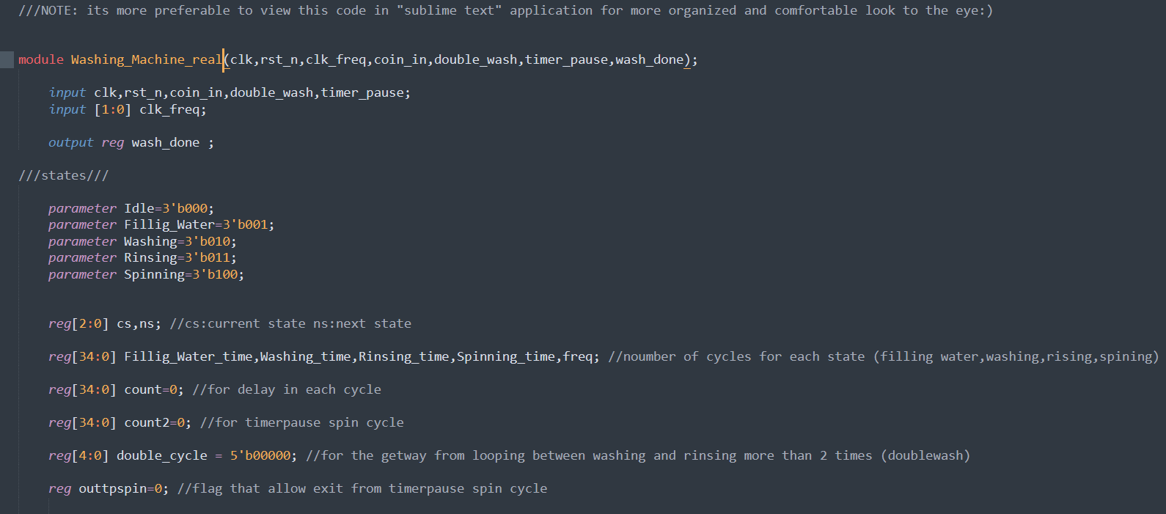
Design code Explanation
First part I stared by defining inputs, outputs.
Then I defined states as parameter
Then Some regs like:
cs: current state
ns: next state
count: which enable program to stay
In the current state till the operation
Time of this state is completed
(same for “count2” but for timerpause)

Slide 9
Design code Explanation
Then Some regs like:
double_cycle: A flag that force exit from rinsing state to spinning after double wash
outtpspin: a flag that allow exit from spinning state to idle to allow “wash done =1” when timer pause is used
Filling_water_time,washing_time,etc.:
Registers that contain the number of
Operation cycles of each state.

Slide 10
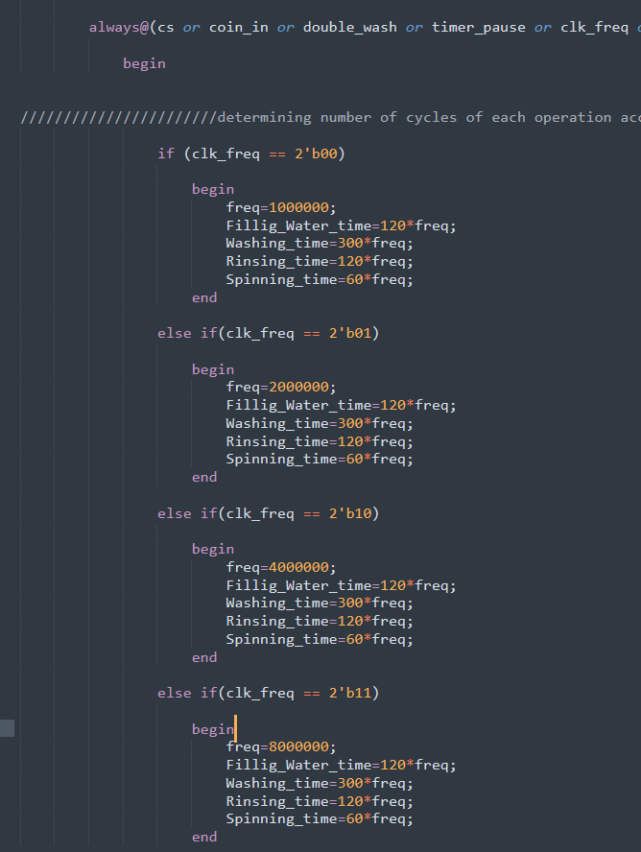
Design code Explanation
Second part I calculated the number of
Operation cycles of each state with respect to
Each frequency of the four given frequencies
Associated with “clk_freq” input.

Slide 11
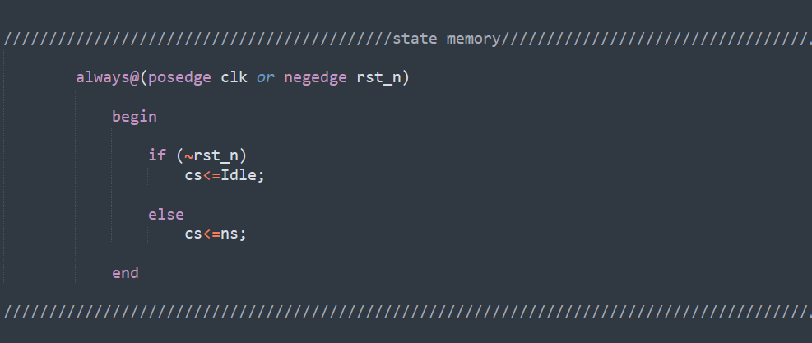
Design code Explanation
Third part at bottom of code there is state memory which is responsible for moving from current state to the next state every positive edge of clock came, or negative edge reset. And make current state zero “idle” when reset is zero.

Slide 12
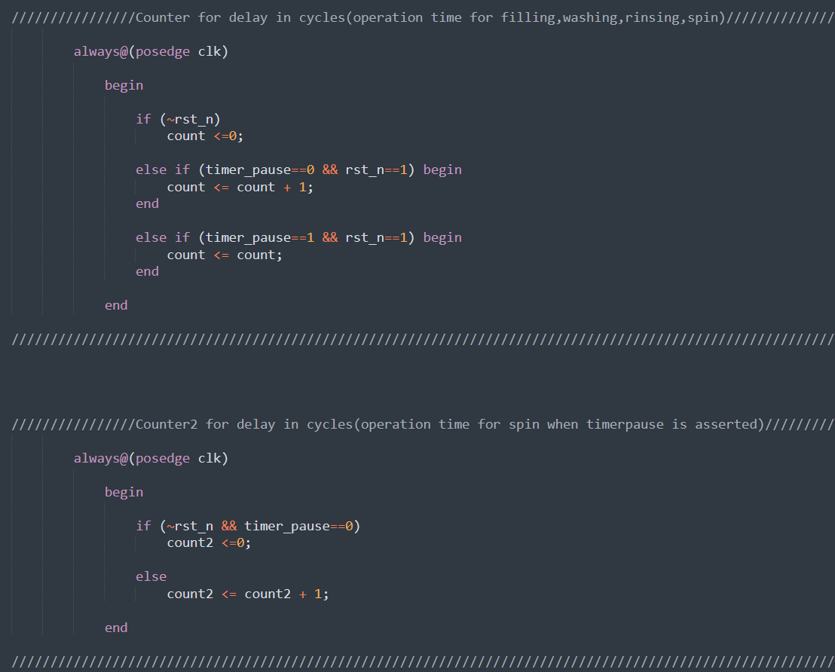
Design code Explanation
Fourth part also at bottom of code I used
Counter “count” to allow me to stay at state until
Time duration of state is done (explained more at
States).
”count” value keep increasing when timer
Pause is 0 when it is 1 it stops saving value of
Number of cycles done in “spinning” state, so
After the timer pause reassert and back to “spinning”
It knows the remaining number of cycles.

Slide 13
Design code Explanation
”count2” is used so that it allow program to leave the “idle” state and to “spinning” state when timer pause is reasserted as it act as a condition in “idle” state “count2>0” as it value stared to increment when timer pause is asserted

Slide 14
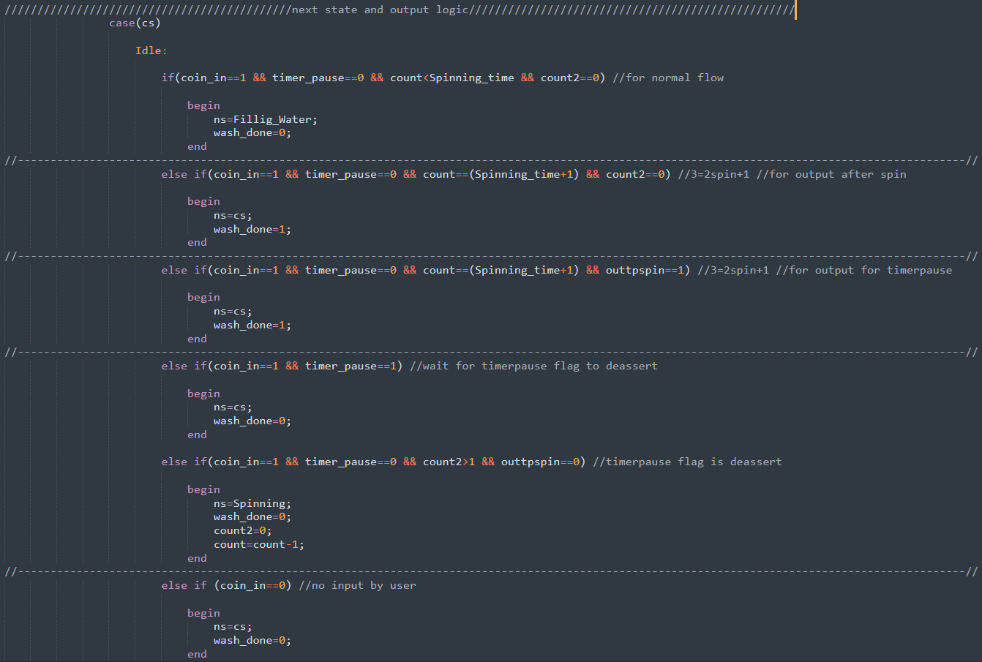
Design code Explanation
Fifth part
first section allow normal
Flow of code as “count2” is 0 because
it start counting when timer pause is
Asserted and “Spinning_time” is
larger than “count” (its order million).
second section allow output to be 1
after The “spinning” cycle is finished
and Timer pause hasn’t asserted ever.

Slide 15
Design code Explanation
third section allow output to be 1
after The “spinning” cycle is finished
and Timer pause has asserted and later
Is disserted and we differentiate this condition
From previous in second section by “outtpspin”.
fourth section first condition is to make machine
Stays in “idle” till timer pause dissert ,second
To move it to spinning to complete its operation.
Time.
fifth section no coin is given to the machine
it wait at “idle”.

Slide 16
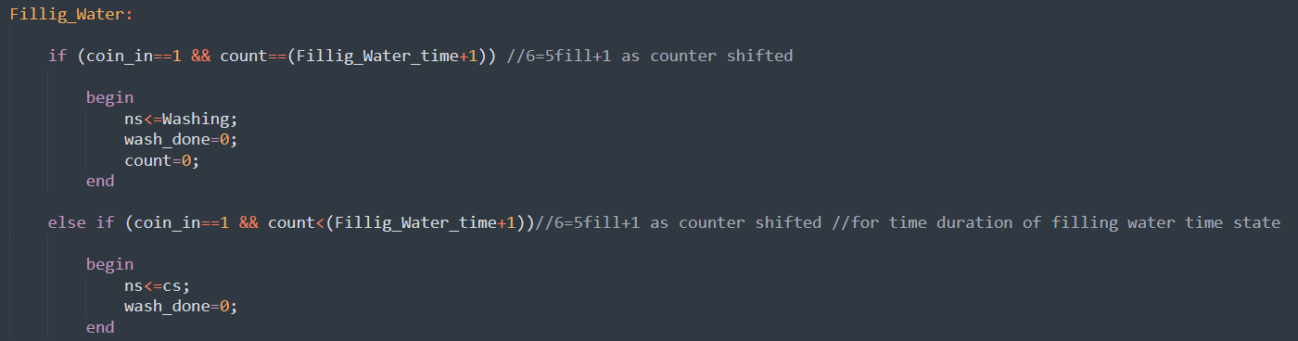
Design code Explanation
Sixth part is the filling water state where it stays in this state as long as count is less than the number of operation cycles “Filling_water_time”. Then moves to next state after that.

Slide 17
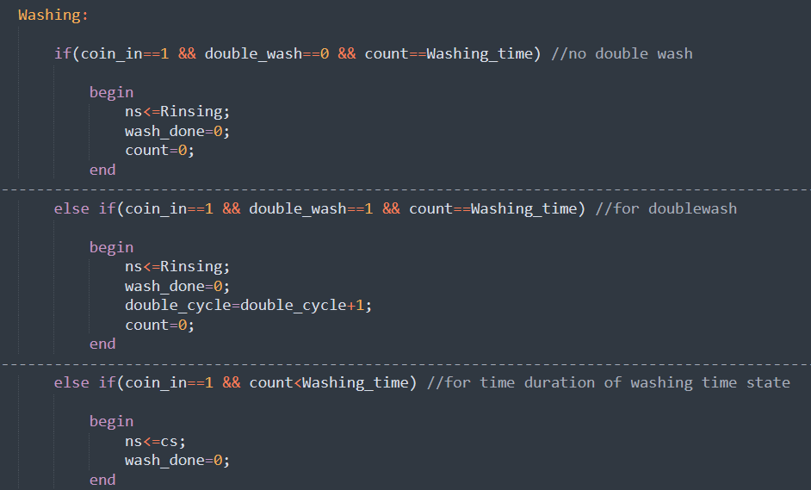
Design code Explanation
Seventh part
first section in the “washing” state moves machine to
Next state as long as the third section is finished which
Force machine to stay in washing till operation time has
Passed.
Second section is responsible for the double wash
when it's asserted a variable called “double_cycle”
Is incremented that allow the machine to exit to spin
State when its equal to 3(more explanation next slide).

Slide 18
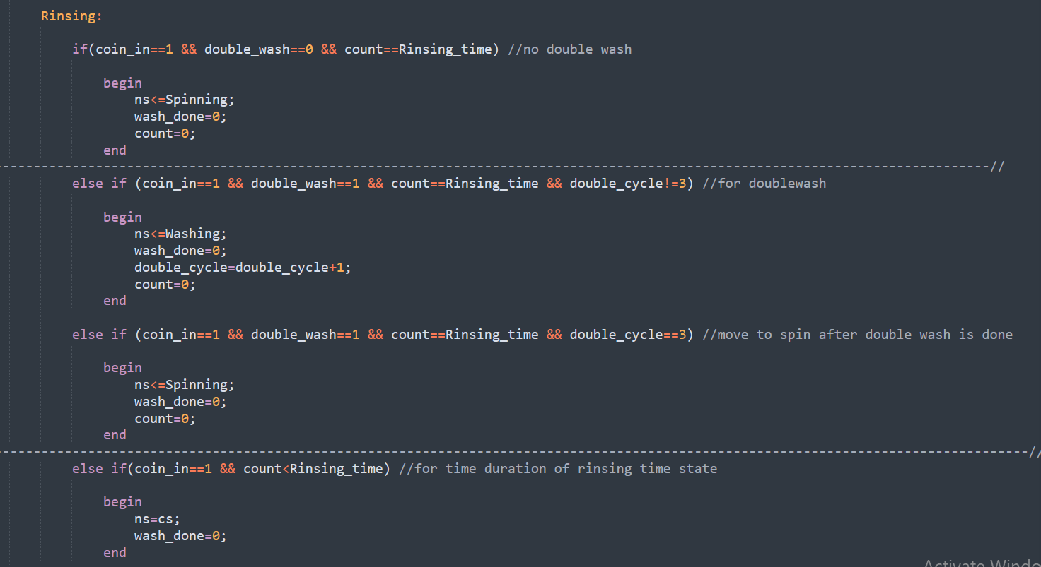
Design code Explanation
Eighth part
first section in the “rinsing” state moves
machine to Next state if the third section is
finished which Force machine to stay in rinsing
till operation time has Passed.
Second section is for the double wash when its
Asserted as it make machine go back to washing
Then moves to rinsing then to spinning by the
Help of “double_cycle” flag.

Slide 19
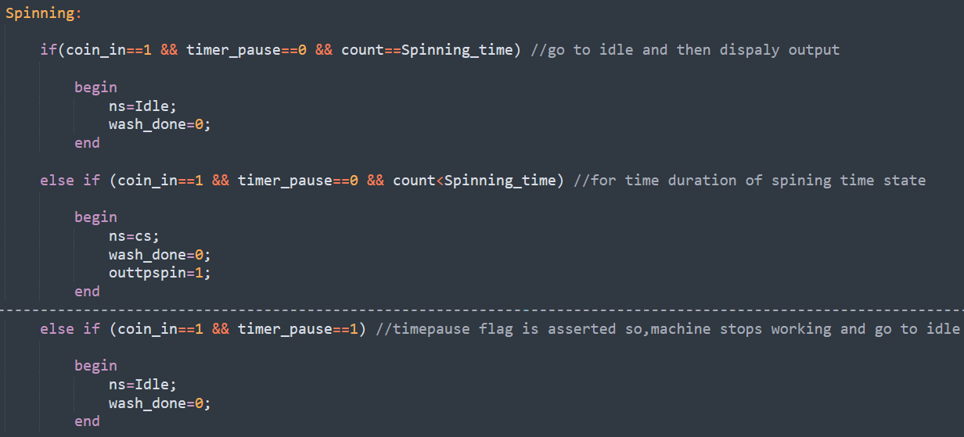
Design code Explanation
Eighth part
first section in the “spinning” state moves machine to Next state “idle” where output “wash done” equals 1.if the second part of this section is finished that is responsible for Forcing machine to stay in rinsing till operation time has Passed.
Second section is when the timer pause is
asserted the machine needs to stop Working so
it force it “idle” state till the Timer pause is
reasserted it can return back to spin to see
whether its operation time has finished so
output (wash done) become 1 or it wait for
operation time to pass

Slide 20
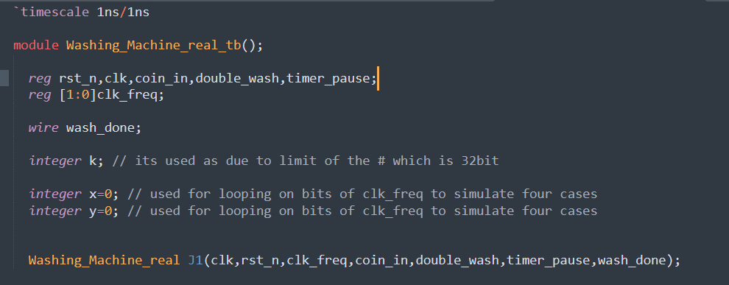
Testbench Explanation
First part
K: I used later in loops as maximum value I can set for delay after “#” is in 32-bit
X,Y: I used them as first ,second bits of “clk_freq” for looping to allow testing all 4 Frequencies
Finally, I called the module name of the design

Slide 21
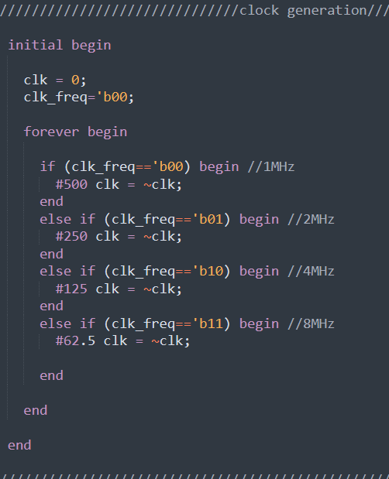
Testbench Explanation
Second part
Here I generated each clock with it’s frequency by
Using “forever” methd; for example,
clk=0 for 500ns then
Clk=1 for following 500ns

Slide 22
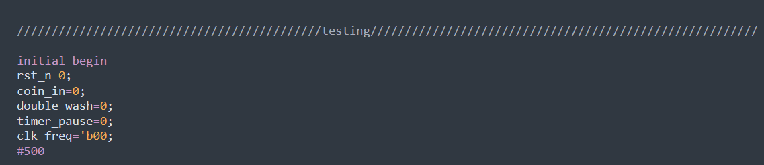
Testbench Explanation
Third part
Initially putting all inputs zeros before start giving them values for testing and a delay of 500ns before beginning.

Slide 23
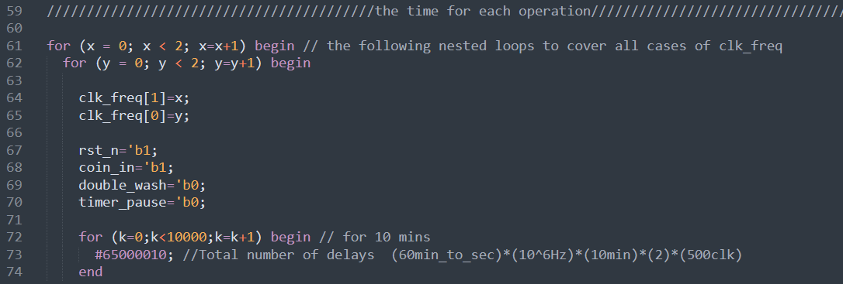
Testbench Explanation
Fourth part
First as shown I looped over X,Y that represent first, second bits of “clk_freq” to allow same test bench to test all four cases of frequency, instead of writing code 4 times.
Lastly, I made for loop for the delay as maximum value I can set for delay after “#” is in 32-bit,so the delay in this example can be #650000100000
From this loop that last the total time of whole operation I can test time of each operation

Slide 24
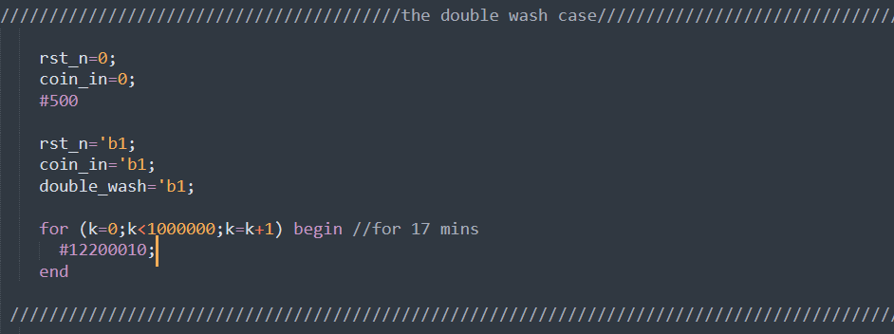
Testbench Explanation
Fifth part
Here I tested the double wash case, so I raised “double_wash” flag 1
I also set the “rst_n” and “coin_in” to 0 as they are incremented previously with values from previous cases simulation

Slide 25
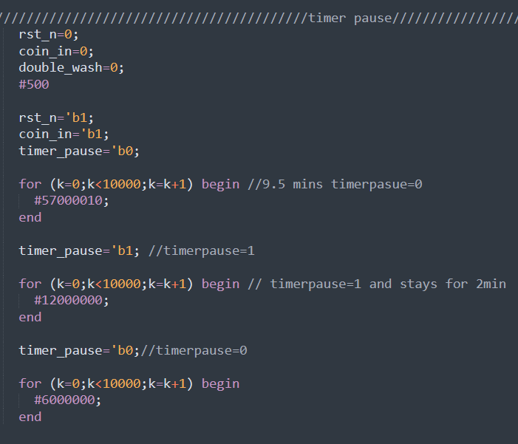
Testbench Explanation
Sixth part
After I waited for the spin cycle to come and waited
half of it’s operation time to pass(30 seconds) by the
Help of the first for loop, timer Pause flag is asserted
And stays on for 2 minutes by the second for loop, then
Timer pause is reasserted back off and stays that way

Slide 26
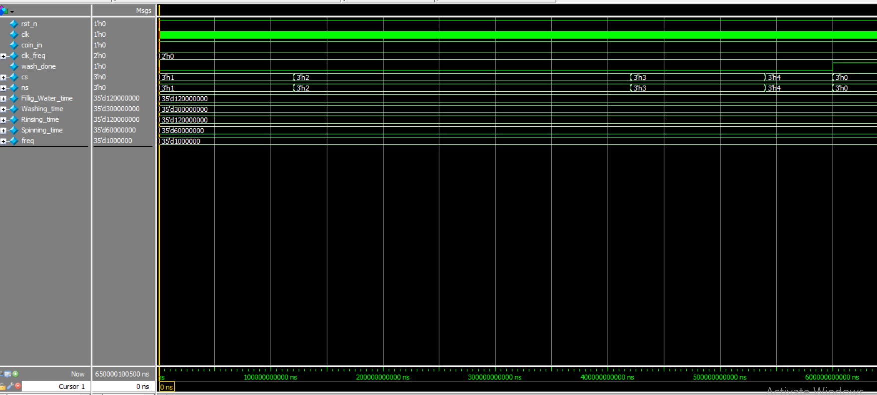
Test cases for 1MHz clock frequency
Here I tested the full time of the program which is 10 minutes(notice bottom of pic for the time)
0:idle
1:filling water
2:washing
3:rinsing
4:spining

Slide 27
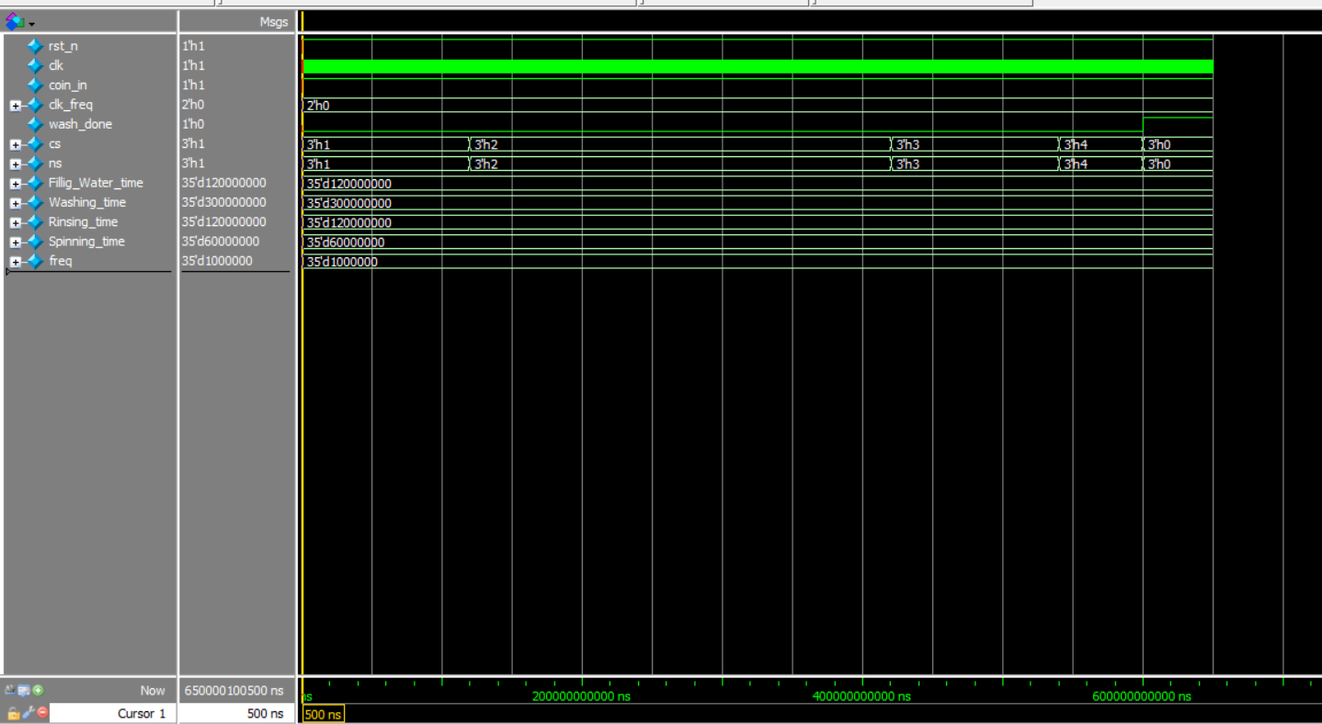
Test cases for 1MHz clock frequency
Here is the start of machine (note yellow cursor number)
0:idle
1:filling water
2:washing
3:rinsing
4:spining

Slide 28
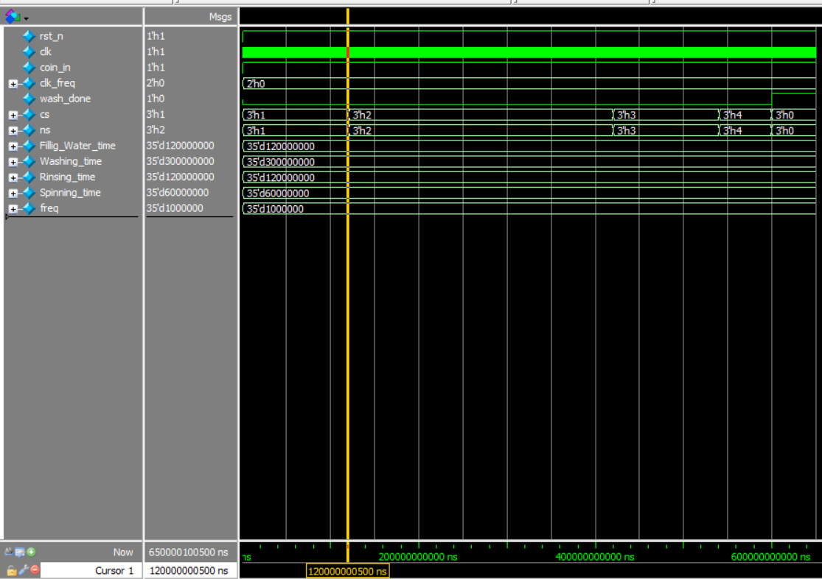
Test cases for 1MHz clock frequency
Here is the time taken for first state ”filling” (2 min) (note yellow cursor number)
0:idle
1:filling water
2:washing
3:rinsing
4:spining

Slide 29
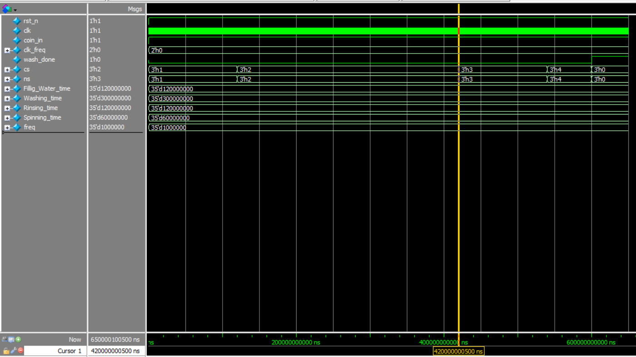
Test cases for 1MHz clock frequency
Here is the time taken for second state ”washing” (5 min) (note yellow cursor number)
0:idle
1:filling water
2:washing
3:rinsing
4:spining

Slide 30
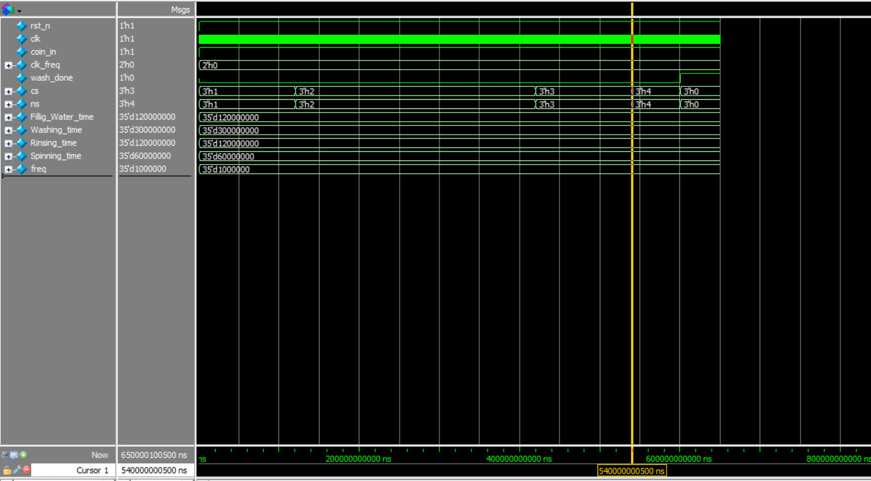
Test cases for 1MHz clock frequency
Here is the time taken for third state ”rinsing” (2 min) (note yellow cursor number)
0:idle
1:filling water
2:washing
3:rinsing
4:spining

Slide 31
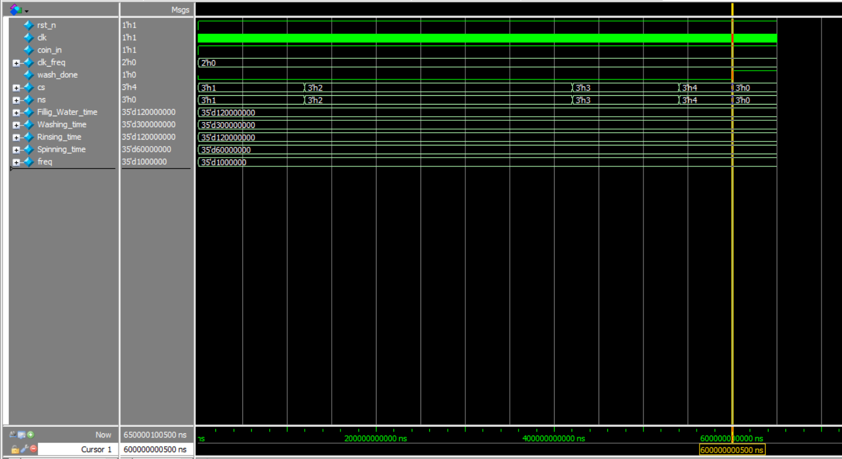
Test cases for 1MHz clock frequency
Here is the time taken for fourth state ”spinning” (1 min) (note yellow cursor number)
0:idle
1:filling water
2:washing
3:rinsing
4:spining

Slide 32
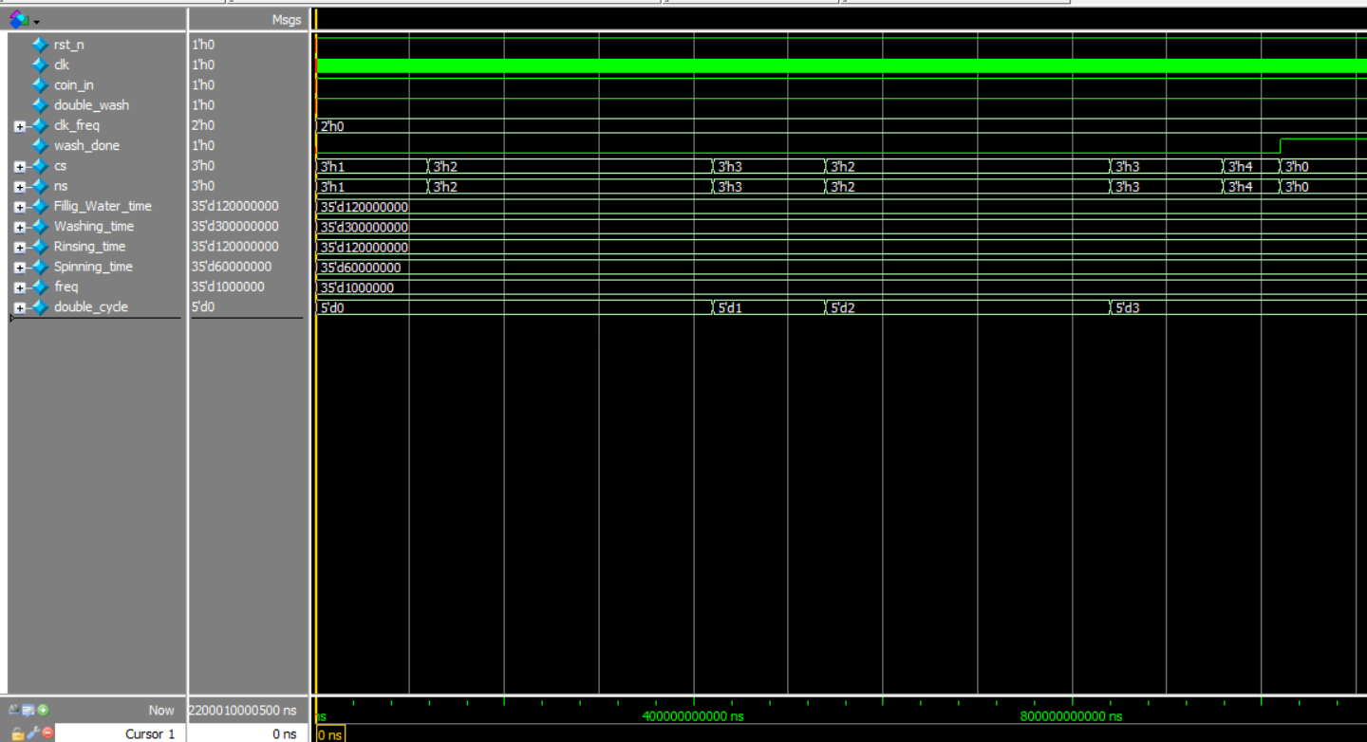
Test cases for 1MHz clock frequency
Here I tested double wash option
0:idle
1:filling water
2:washing
3:rinsing
4:spining

Slide 33
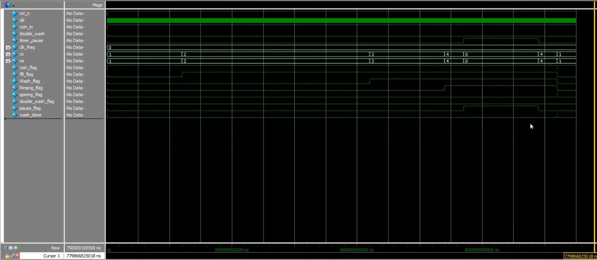
Test cases for 1MHz clock frequency
Here I tested timer pause in the middle of spin cycle

Slide 34
Test cases for simpler code
Here I am working with:
Clock:0.5GHz
Filling Water time: 10ns
Washing time: 8ns
Rinsing time: 6ns
Spinning time: 4ns
0:idle
1:filling water
2:washing
3:rinsing
4:spining

Slide 35
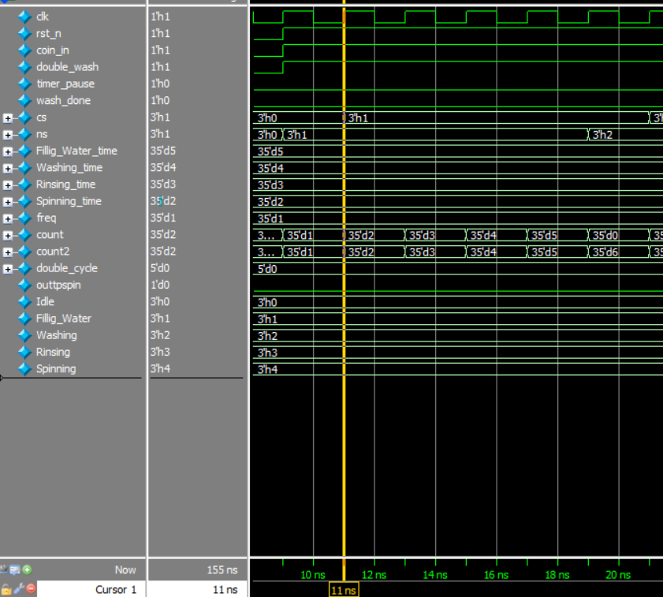
Test cases for simpler code
Here Filling Water time: 10ns (note number of clock cycles in pic 5 cycles)

Slide 36
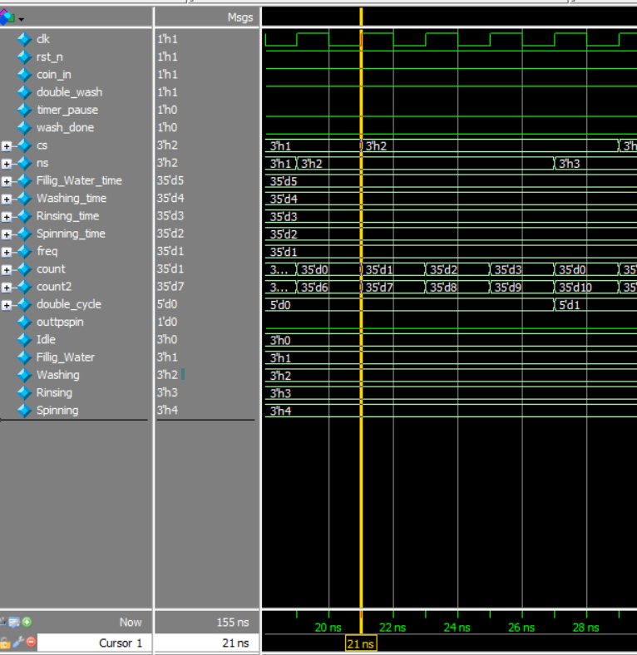
Test cases for simpler code
Here Washing time: 8ns (note number of clock cycles in pic 4 cycles)

Slide 37
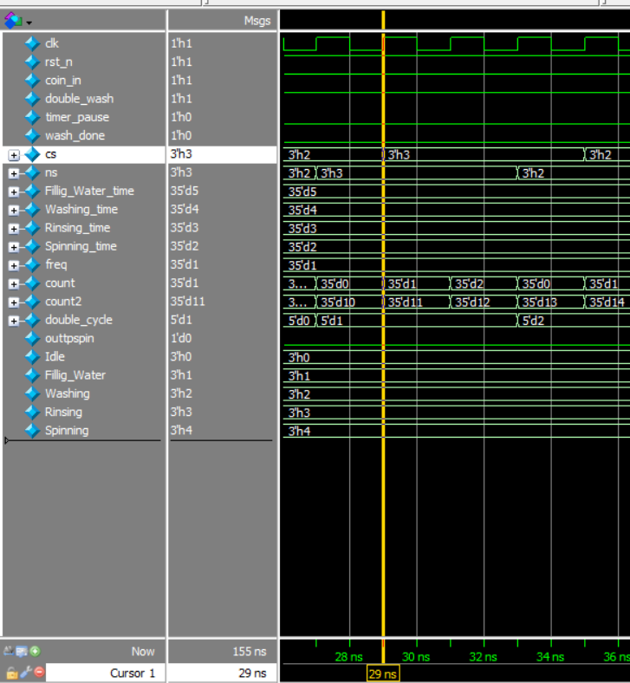
Test cases for simpler code
Here Rinsing time: 6ns (note number of clock cycles in pic 3 cycles)

Slide 38
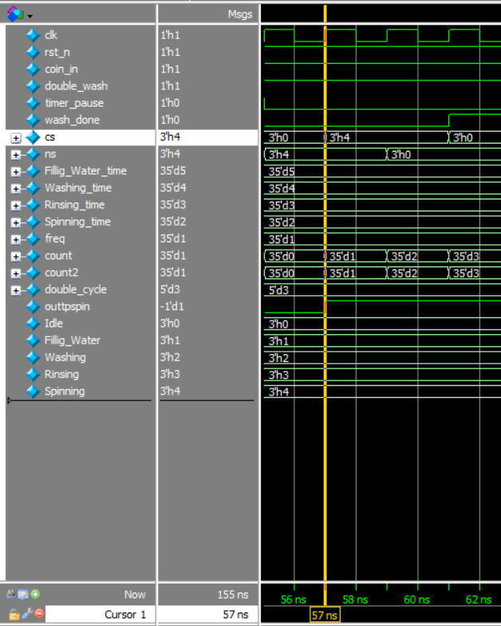
Test cases for simpler code
Here Spinning time: 4ns (note number of clock cycles in pic 2 cycles)

Slide 39
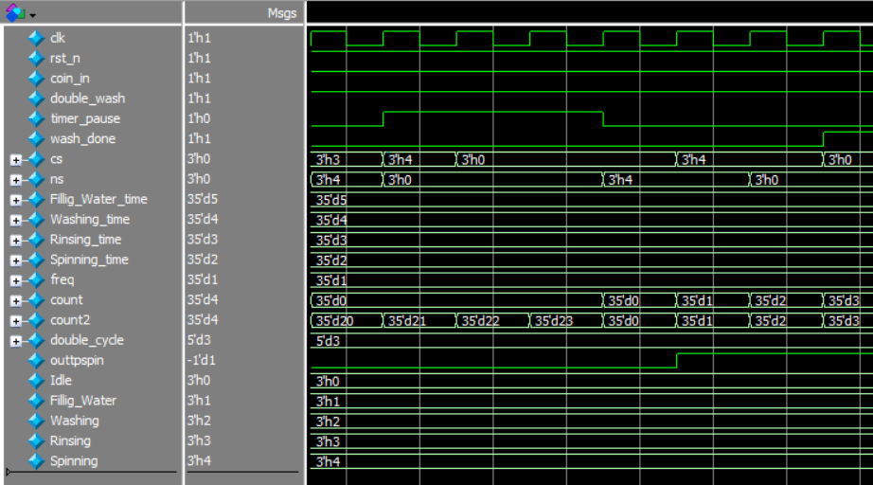
Test cases for simpler code
Here notice how timer pause is asserted at start of the ”spinning” cycle, it went to “idle” then when timer pause is reasserted it completed the cycles of spinning and output become high

Slide 40
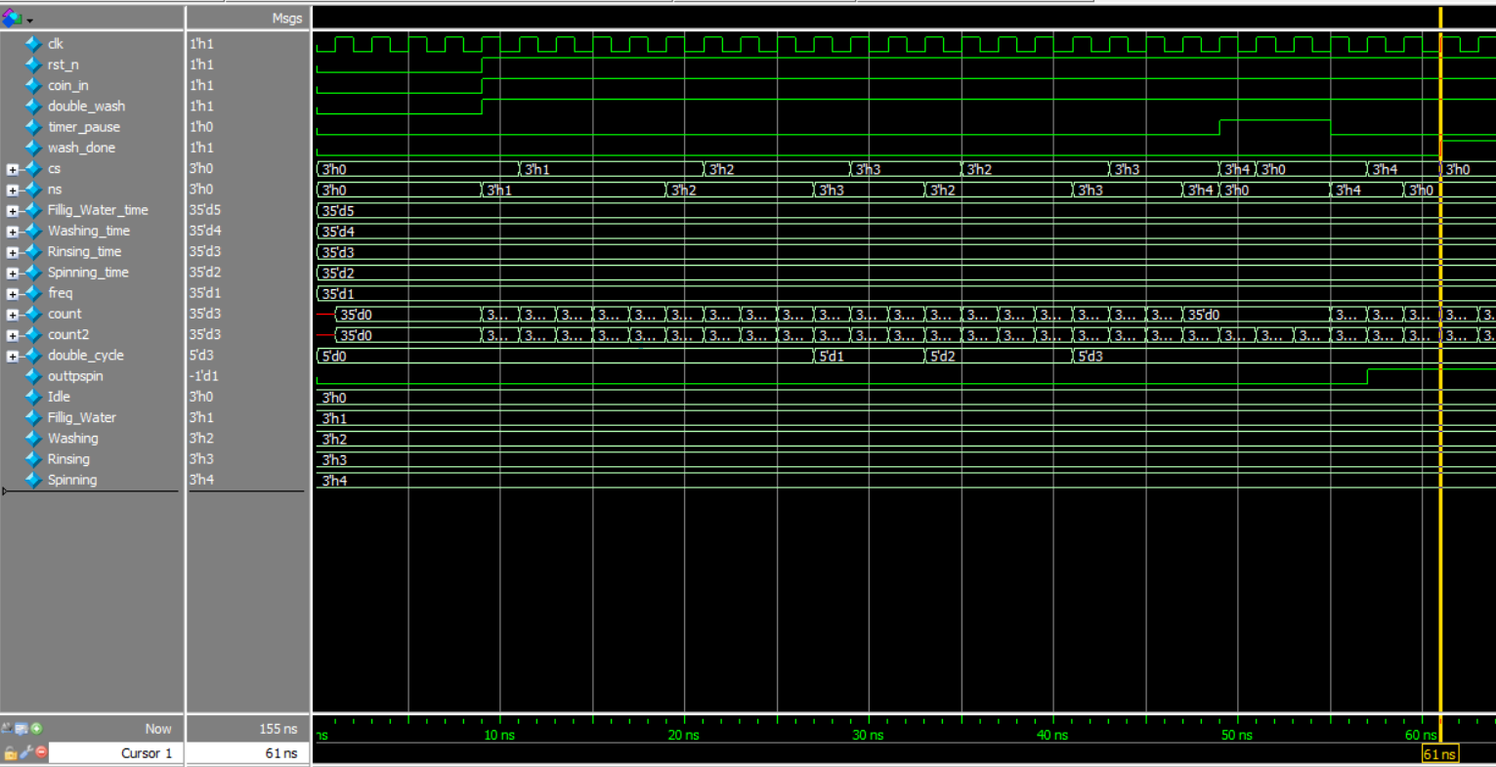

Test cases for simpler code
Here notice the double wash from state 2 to state 3 back to state 2 to state 3 then to state 4

Slide 41
Test cases for simpler code
Overall view :
Double wash on
Timer pause on

Slide 42
THANK YOU

